Slide 1


Zest Team 11
ADV 3008 M/W
Team Clean:
Aaron Greenfield
Kiffanie Shoults
Jared Liebmen
Bryan Scott

Slide 2
Business Situation and Problem
Zest, a Cleaner Clean, a Fresher Start
Zest’s presence in today's market as a competitive brand is becoming weak; introduce Zest into a new generation of users to revive the brand.

Slide 3
SWOT Analysis
Strengths: Was a very well known brand Logo and brand recognized internationally Multi-million dollar budget available to continually promote the brand? | Weakness: Zest has been out of the “spotlight” for a while. There are many well know body heigenic products. The average person does not necessarily know that Zest carries what was a well-known brand at one point
Opportunities: Overcoming the “slump” they are in Regain respect and credibility To position themselves as one of the top soaps if not the top soap. | Threats: Well established companies that pose a challenge to surpass Sluggish economy Many older people use Zest, not the younger generation

Slide 4
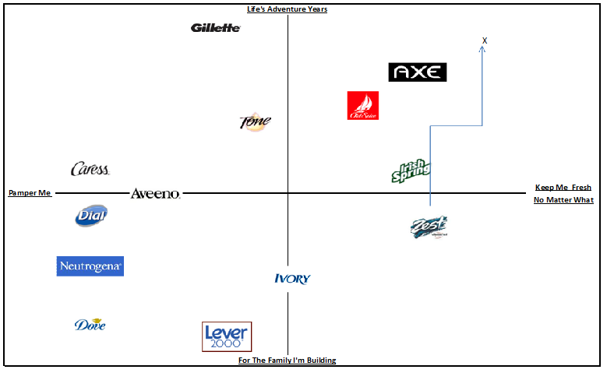
Competitive Map

Slide 5
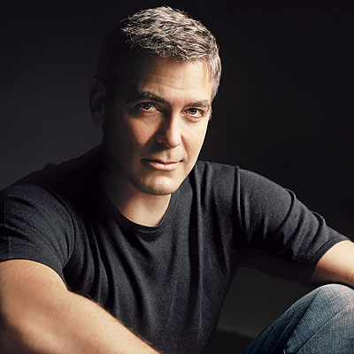
Brand Personality
George Clooney
Why George Clooney?
A well recognized and respected product.
An iconic figure and household name.
Ageless and peculiar

Slide 6
Positioning Statement
Zest, Don’t Wear Your Soap
To the young American man with an appetite for independence and success, Zest is the brand as superior as you strive to be.

Slide 7
Strategic Message Map
Advertising Objective: To introduce Zest to a new generation of consumers.
Core Target Profile: Young adults both men and women with a passion for life that what more out of a soap/body was that they cant get anywhere else, Dedicated ambitious sparkling clean people.
THINK NOW
DO NOW
DIFFERENTIATING PROPOSITION
THINK IN FUTURE/
DO IN FUTURE
I enjoy feeling clean.
I don’t like cleaning my bath tub.
I like feeling fresh and clean for the opposite sex.
Zest has what I need to push myself first thing in the morning.
I just feel much cleaner when I use it
Zest improves my day.
Zest is Awesome.
Zest, a cleaner clean, a fresher start
.
SUPPORT
TONE & MANNER
MANDATORIES
Empowering, Fresh, Fun, Bright
Bright colors and Zest logo

Slide 8
Introductory Campaign proposal
Types of Ads
  We will advertise using Facebook by create interactive games to appeal to new younger consumers. The games and ads on Facebook will include special offers to entice Facebook users to use Zest products such as coupons or promotional sales for new products to be released.
  We will also be advertising with television, magazine ads, and Billboards. This will allow us to make consumers aware of Zest’s newer products, such as the body wash series by giving them a visual of the new Zest.

Slide 9
Purpose for Campaign
The reason for our repositioning campaign of Zest is; Zest soap used to be a highly recognized and competitive soap brand that had good brand promotion and an innovative product, but as other products such as old spice and axe came on to the market Zest faded in to the background. With our new campaign we will attempt to restore Zest to its former glory by raising brand awareness and loyalty through our new ads on television, magazine ads, Billboards, and on the Internet.
http://zest.com/

Slide 10
Facebook
Why Facebook ?
What will it look like?
Many Facebook users are the age of our target market.
Facebook is able to provide an interactive element that other mediums cannot.
A simple, interactive game located in the right advertising column of Facebook.
Roll your cursor over the fogged mirror before it can fog up again and win a Zest coupon.

Slide 11


Billboards

Slide 12

Commercial Ideas

Slide 13
Promotions
Facebook
Billboards and Commercials
Test the Zest, Facebook challenge
Build Brand Loyalty
Collaborating with organizations to build a strong brand image.
Build brand awareness among the local communities.
Provide new users piece of mind
Billboards and slogans
Appeal to consumers sense of feeling
Create sex appeal
Working with local businesses
Build Consumer awareness

